Slide 1
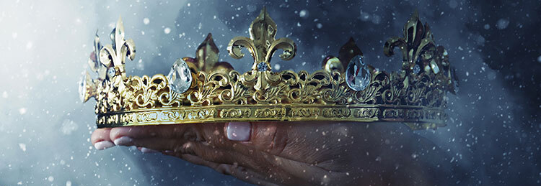
BIBLE STUDY 3 REWARDS OF FAITHFULNESS

Slide 2
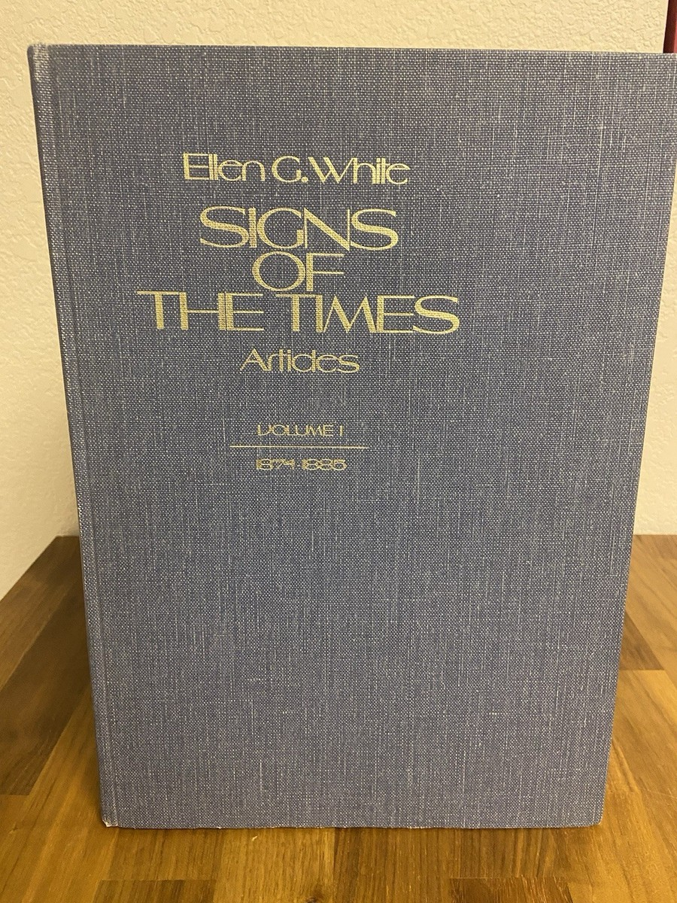
“Yet there will be no one saved in heaven with a starless crown. If you enter, there will be some soul in the courts of glory that has found an entrance there through your instrumentality . . . If the rich blessing of Jesus is in your hearts, you will be able to refresh others.”
The Signs of the Times June 6, 1892, par. 2).

Slide 3
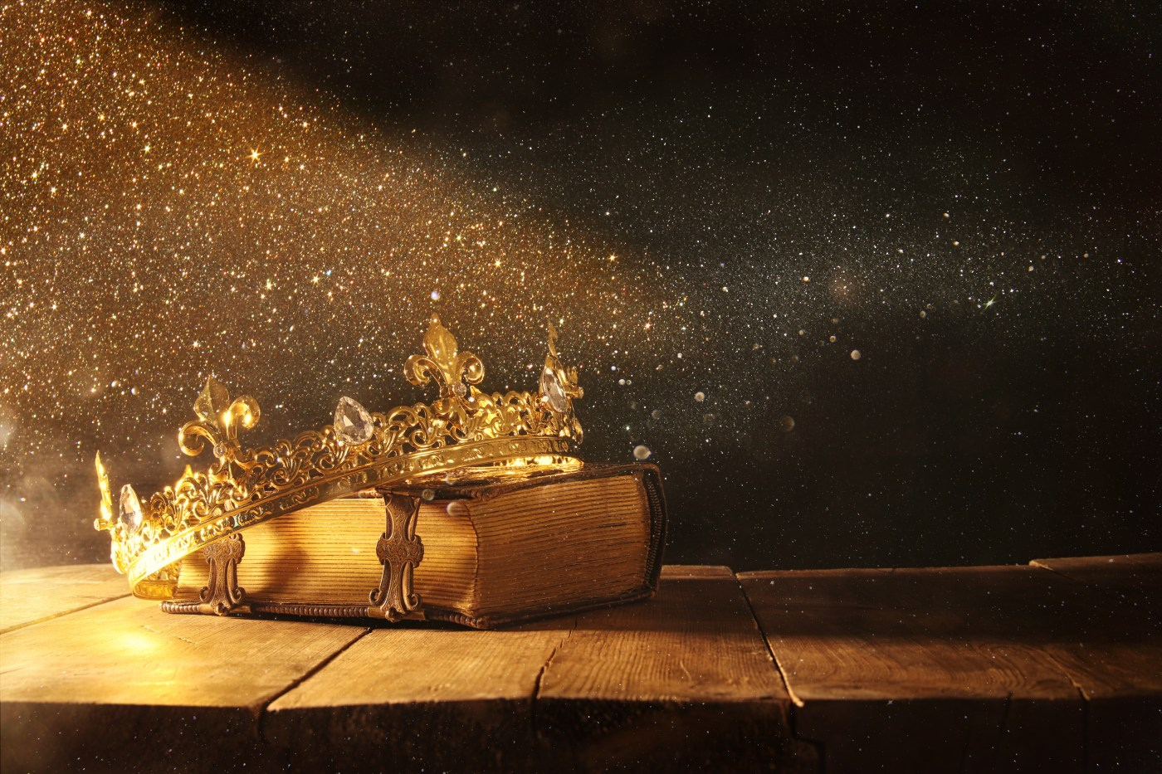
Have we already earned enough stars for our personal crowns that we don't need any more?
Notes:
In this lesson, we will explore the theme "Reward of Faithfulness" in two parts. First, we will look at the different aspects of the reward of faithfulness, both what we experience now and what is to come. Second, understanding Jesus as our eternal reward invites us to embrace this new perspective.

Slide 4
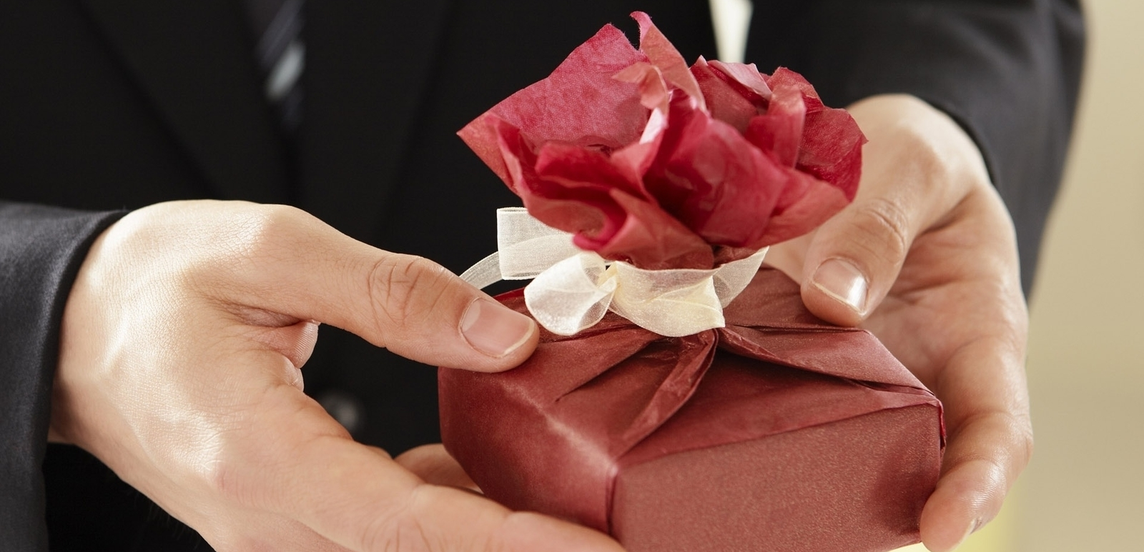
Shades of Reward of Faithfulness

Slide 5
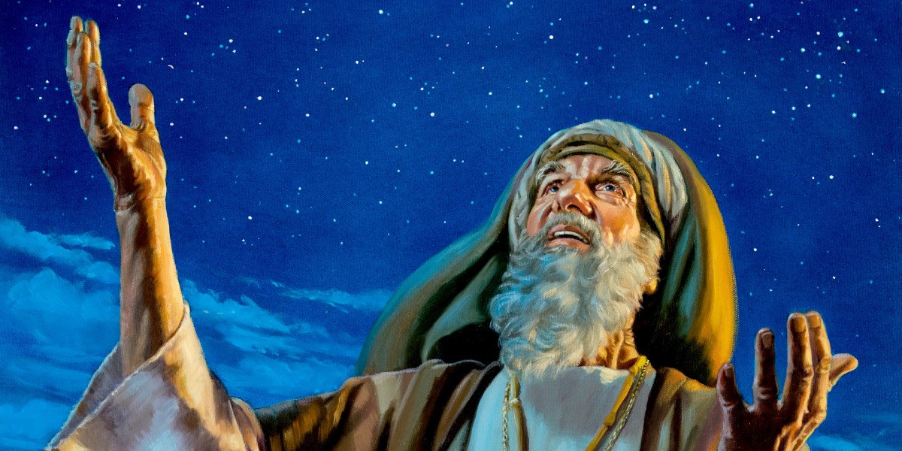
In Gen 15:1, God describes Himself to Abram as “. . . ‘Do not be afraid, Abram. I am your shield, your very great reward” (NKJV).

Slide 6
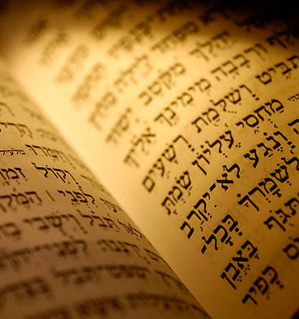
The Hebrew word sachar is translated as "reward" here, which suggests a form of payment or compensation for services provided.
It indicates that God will guarantee Abram's loyalty to the covenant.

Slide 7
In Ghana, there's a saying that goes, "when you trade with God or invest in God, you never lose" (refer to Isa 40:10 for similar usage).
Additionally, there are other Hebrew terms like gemul and shillum that are translated as "requital," which also express the idea of retribution for the wicked (Ps 91:8; 94:2; Isa 3:11).
Notes:
Interestingly, the reward given to the faithful is beyond measure, while the punishment for the wicked is in proportion to their wrongdoing.

Slide 8
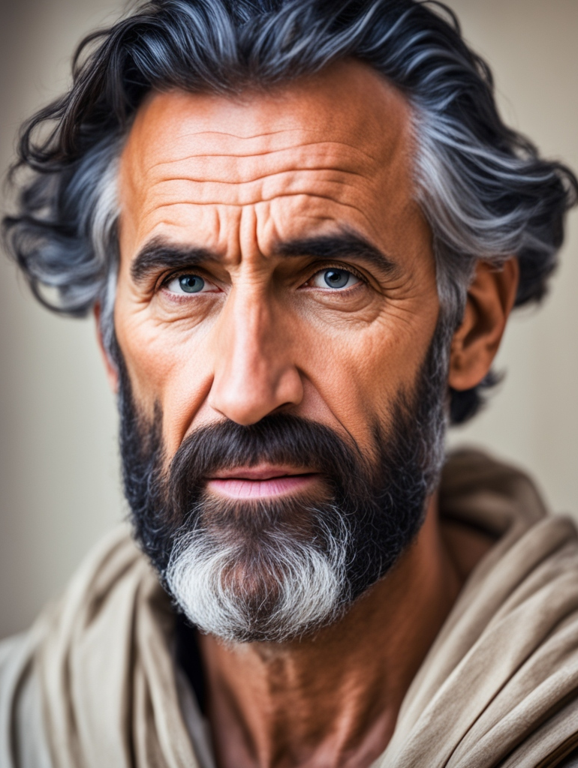
(1 Cor 9:24, NIV)
Notes:
Paul says, "Don't you know that in a race, all the runners compete, but only one wins the prize? Run in a way that you can win the prize" (1 Cor 9:24, NIV).

